Slide 1
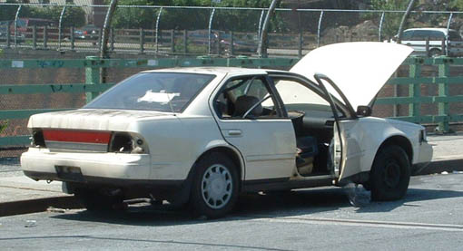
Chicago’s Abandoned Cars
MAT 442 Natasha Polishchuk March 14, 2015
Image: http://www.streetsblog.org/2006/08/01/eyes-on-the-street-above-the-cross-bronx-expressway/

Slide 2
Purpose
Examine the problem of abandoned cars.
Characterize the cars reported to 311
Characterize their locations
Form a model for the city’s response

Slide 3

Why have a car?
Transportation not equal in city limits
Vulnerable to crime
Vulnerable to hit and run
Access outside of city
Transport small children
Notes:
Easier to use train and bus downtown or the more compact Lakeside/North side area. Cars are more expensive for those with lower income, bc they typically pay higher interest rates for a depreciating asset, sometimes ending upside down on a loan. Car figures centrally into financial difficulties and social anxieties.

Slide 4

Why are cars abandoned?
Arrest
Broken down/Disrepair
No money for registration
Accident
For sale
Stolen
Illness
Notes:
This can cause a nuisance, taking up limited neighborhood parking, causing increased pollution (for example, leaking oil), decreasing real estate value.

Slide 5
Data Source
City of Chicago Data Portal
https://data.cityofchicago.org/Service-Requests/311-Service-Requests-Abandoned-Vehicles/3c9v-pnva
A vehicle can be classified as abandoned if it meets one or more of the following criteria:
Undriveable.
Has not been moved or used for more than 7 days.
No state registration for more than 2 days.
Hazardous.
N = 63,386. Population = All Chicago abandoned cars since 2013 in the city limits. Like all real-world data, there are missing values, duplicates, and garbage.
Notes:
Data cleaning: Removed 16k values marked as duplicates, 0 for all days parked values greater than 1000 and less than 0 (negatives are not meaningful), 0 for unknown wards transit score, 0 for makes that are trailers, motorcycles, or unknown. 4k are still open, SAS rejected 15k as incomplete. Therefore, analysis performed on 48k/80k records.

Slide 6
Variables
Completion Date – Creation Date = ComplaintActiveTime
Days Parked
Plate (Out of State, Unknown/IL)
Make (European, Domestic, Asian, Other
Color (Popular, Other)
Status (Open, Closed)
Most Recent Action
Ward (Used to Code Transit Score)
Thoroughfare (Downtown, Major Street, Side Street)
Notes:
The most popular colors are Black, Silver, Gray, White, Red = 1.
Most common actions are “Vehicle was moved from original address requested”, “Need Vehicle Tow Report”. If a vehicle is towed it remains as open, work in progress until it is redeemed, transferred or disposed of. Duplicates were removed.
Transit score by Citizens Taking Action, a public transportation advocacy.
For thoroughfare, downtown = 1, major street = 2, and 0 = side street.
ComplaintActiveTime coded to 1 = over 3 weeks, 0 is less than or still open

Slide 7
Characteristics of Abandoned Vehicles
Origin
Out Of State | 0.5%
In State or Unknown | 99.5%
Maker
Asian | 25.0%
Domestic | 58.6%
European | 7.2%
Other/Unknown | 9.1%
Color
Common | 62.0%
Other | 38.0%
Notes:
Obvious reporting bias, also some bias due to incomplete data

Slide 8
Characteristics of Locations
Location
Side Street | 89.6%
Main Thoroughfare | 6.9%
Downtown | 3.5%
Transit Score
0 | 0.1%
1 | 1.8%
2 | 14.0%
3 | 20.4%
4 | 12.2%
5 | 14.9%
6 | 5.1%
7 | 14.4%
8 | 5.8%
9 | 6.1%
10 | 5.2%
Notes:
Transit score of 1 is the worst, 10 is best. 0 is data without a ward.

Slide 9
Time Intervals
Variable | N | Mean | Std Dev | Median | Skewness
ComplaintActiveTime | 63386 | 19.7 | 17.9 | 17 | 3.7
DaysParked | 63386 | 35.8 | 57.7 | 21 | 6.1
Notes:
Both the mean and median round up to 3 weeks, so that was used as the cutoff to determine whether the time intervals took a long time

Slide 10
City Response
Main Thoroughfare vs. Response Time
Chi-square is 120.97 (df = 2, p <0.0001)
For downtown areas, the abandoned cars complaints are resolved much faster than expected, with cell chi-sq 43.40 for less than 3 weeks and 62.67 for greater.
Notes:
Main streets and side streets are all approximately the same, with chi-sq less than 5.

Slide 11
Correlation Results

Slide 12
Conclusions
The city responds fastest to vehicles downtown.

Slide 13
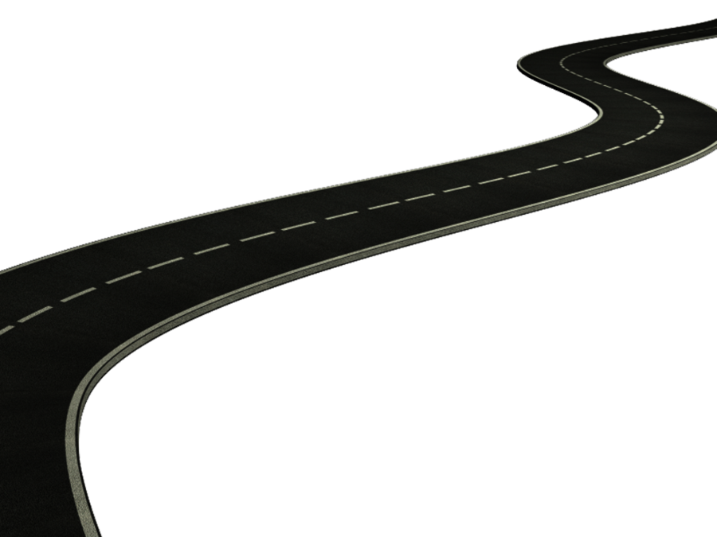
Recommendations
Analyze duplicates to test whether they affect response time
Compare to Chicago suburbs

Slide 14

Limitations
No year data
No model
Missing values

Slide 15
Works Cited

